Slide 1
LEAN INITIATIVES SUPPLY CHAIN MANAGEMENT
Presented by:
Christopher Mele
Administrator of Supply Chain Management
Flagler Hospital
2012

Slide 2
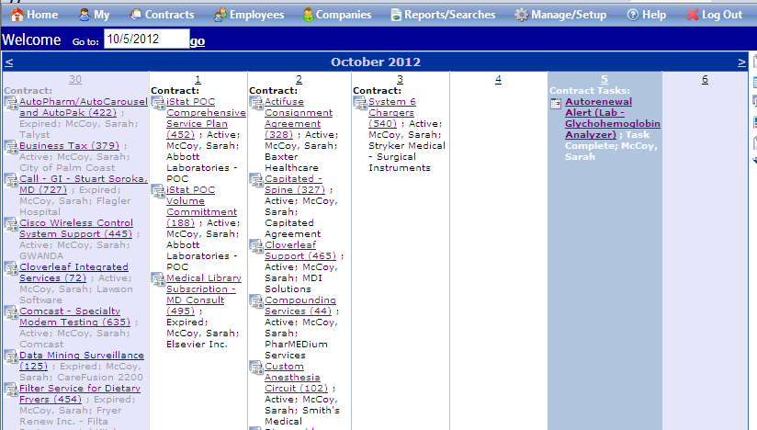
KANBAN CONTRACT PROCESS
Before – Contracts were managed manually and in multiple departments. Many of them would auto renew when we didn’t want them to. We found service contracts that would renew for equipment that we didn’t even own anymore.
After – Cobblestone Systems was implemented. All contracts scanned in PDF and uploaded to system. The system provides a visual control via email to notify us 120 days before contract renewal to both end user that is responsible for the contract, and Supply Chain to ensure that it is being worked on properly. For months in which contracting is light Supply Chain is extending contracts over into that month to more even out the workload.

Slide 3
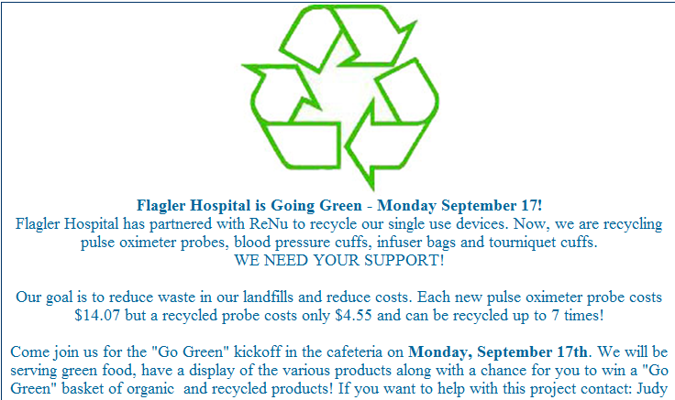
REPROCESSING INITIATIVE
Before – Item used once and then thrown away.
After – Item is used, then thrown into a segregated bag that the vendor picks up. Vendor takes back to their facility, decontaminates it, disassembles, replaces parts when necessary, repackages, and then sells back to us “like brand new” for 50% the cost of a new one. The process has a failsafe built in, if it doesn’t meet the OEM requirements during the reprocessing stage the item is discarded and the hospital isn’t charged. We only pay for the items that come back to us.

Slide 4
POINT OF USE SYSTEM MANAGEMENT
5S POINT OF USE SYSTEM LOCATIONS
ITEMS STACKED ON TOP OF ONE ANOTHER
BULKY RACKS MAKE ROOM SMALLER
NO ORGANIZATION
NO DOCUMENTATION SHOWING WHAT PAR LEVEL SHOULD BE

Slide 5
POINT OF USE SYSTEM MANAGEMENT
PYXIS STOCKS CHARGEABLE ITEMS IN NEAT ORDERLY FASHION
PAR LEVELS ARE BASED ON REAL TIME USAGE SO INVENTORY IS REDUCED
ITEMS NO LONGER STACKED ON TOP OF ONE ANOTHER
BULKY RACKS REMOVED, ITEMS FLUSH AGAINST WALL
COMPLETE ORGANIZATION

Slide 6
DIVISION OF SMALLER INVENTORIES
MANUAL INVENTORIES WERE HUGE, FULL OF THOUSANDS OF ITEMS, IMPOSSIBLE TO MANAGE
PYXIS DIVIDED THE INVENTORY INTO 44 DIFFERENT LOCATIONS MAKING EASIER TO MANAGE.
INVENTORY IS LOCKED UP AND COMPLETELY ACCOUNTED FOR
INVENTORY IS COUNTED ONCE A MONTH, COUNTING PROCESS IS MUCH FASTER WHEN DONE IN INDIVIDUAL INVENTORIES

Slide 7
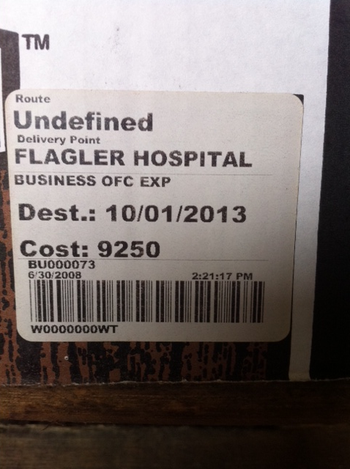
5s Warehouse
Each box is organized by department, date, and palletized and shrink wrapped.
Each box has a WITS label identifiying department, location, box number, and destruction date.
System makes delivery/retreival much faster and records are maintained of when the box is offsite or finally destroyed.

Slide 8
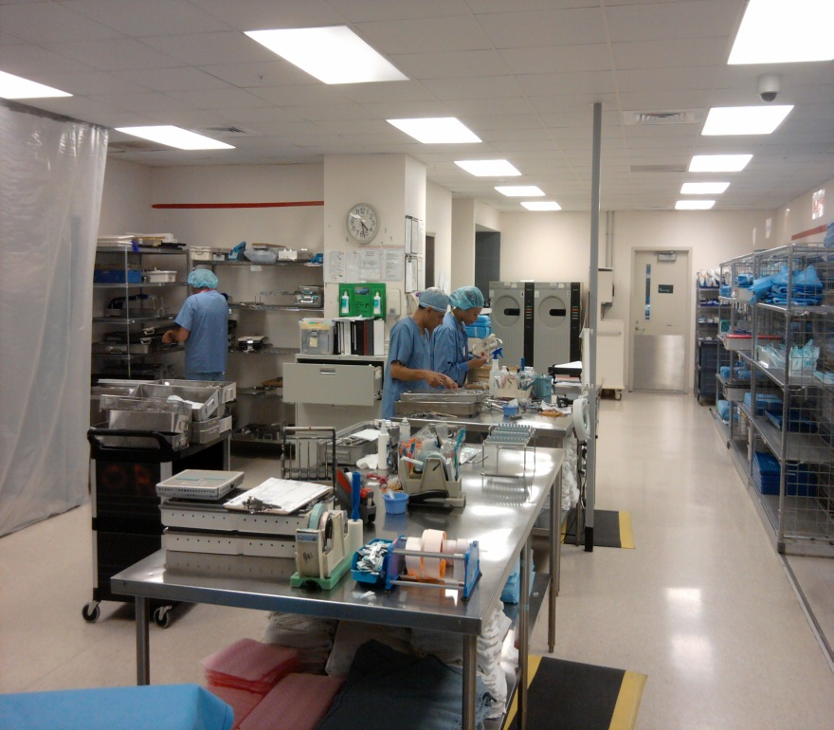
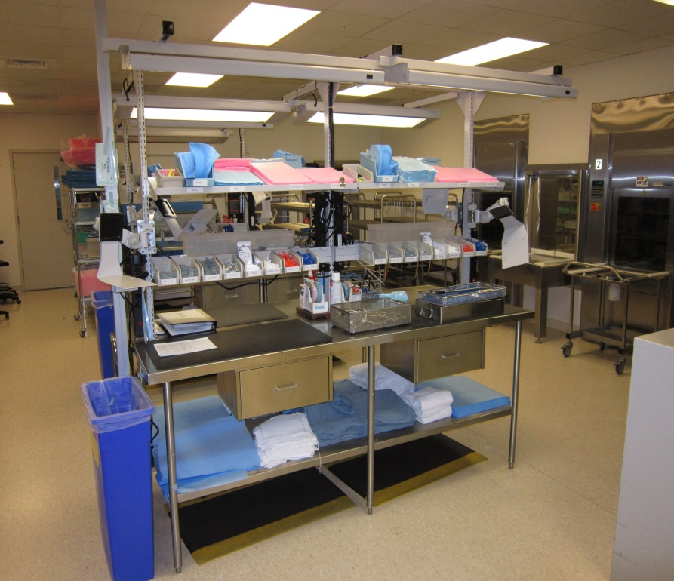
5S STERILE PROCESSING
BEFORE
AFTER
Before – Assembly tables had supplys strewn across it. Most of the supplies were in cabinets on the decontam side of the department, so staff had to walk over there every time they needed something.
After – New workstations not only have all the supplies they need in an organized easy to reach manner, but all of the workstations are identical making their work easier.

Slide 9
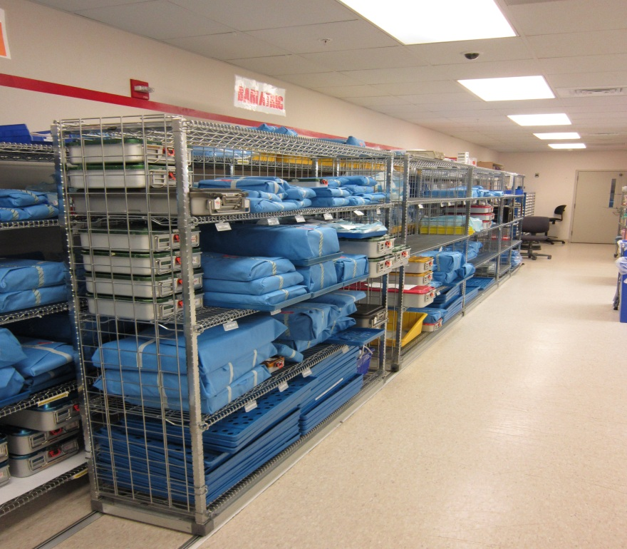
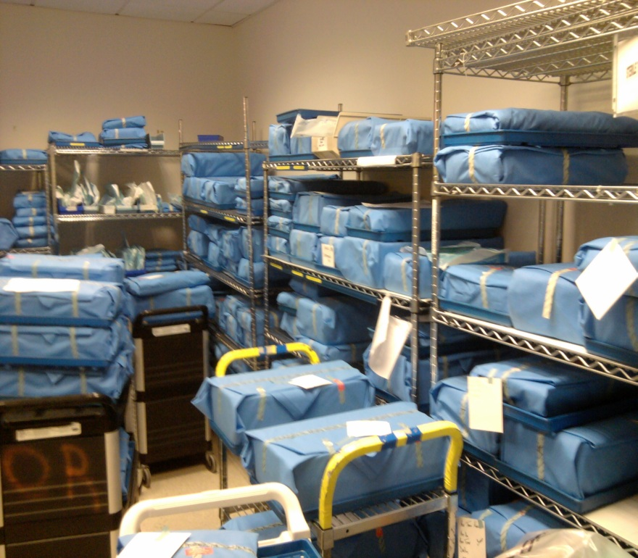
5S STERILE PROCESSING
BEFORE
AFTER
Before – Finished goods were stored on racks in no particular order, carts got in the way of getting to them.
After – Movable rack system allowed better storage. All trays are stored in alpabetical order by Manufacturer so they are easier to get to and account for.

Slide 10
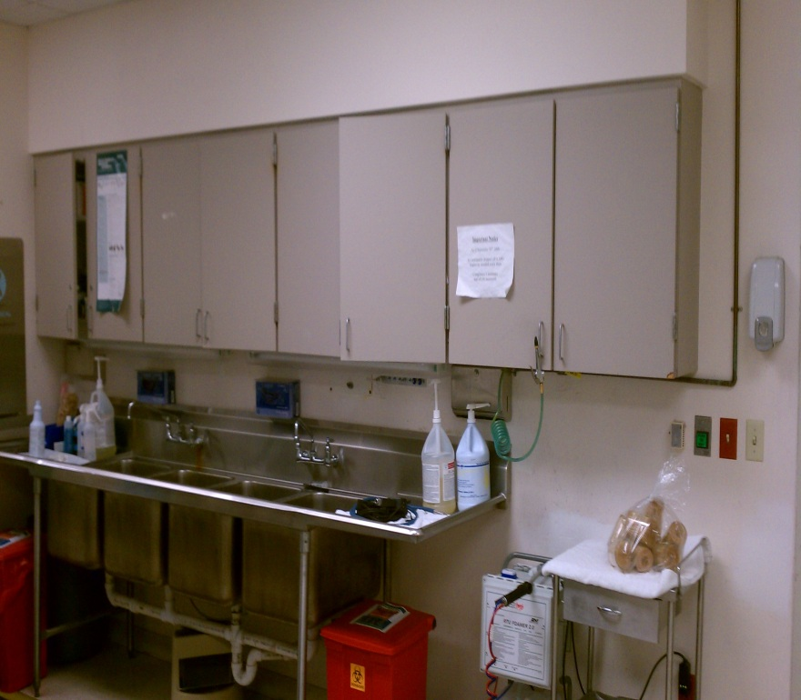
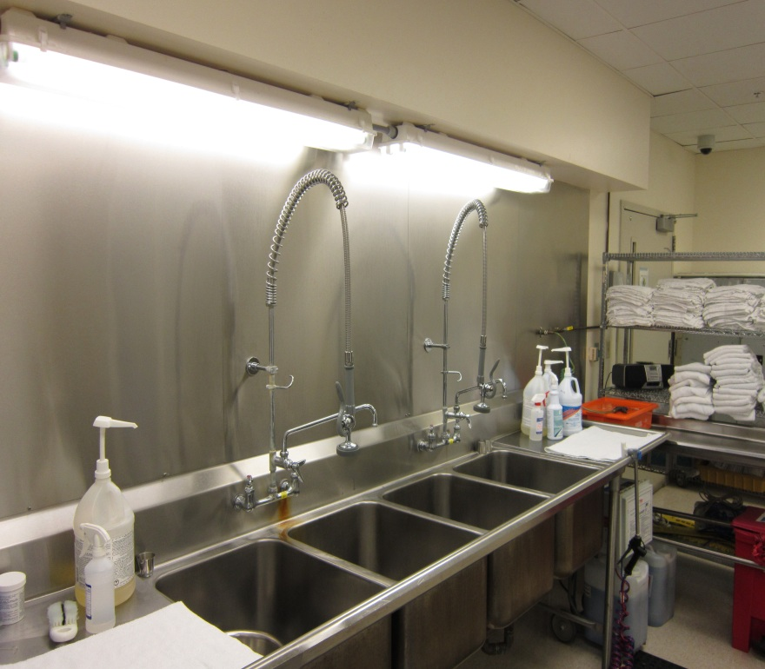
5S STERILE PROCESSING
BEFORE
AFTER
Before – Decontam area had cabinets above that weren’t full of supplies. The supplies that were in the cabinets were needed across the other side of the department. In addition, bodily fluids would splash up inside and behind the cabinets, a sanitation issue for the hospital.
After – Installed high pressure faucets to break down bodily fluids and tissue that cakes up on the instrumentation, and installed a stainless steel backsplash to make the area more sanitary. Supplies relocated to the workstations.

Slide 11
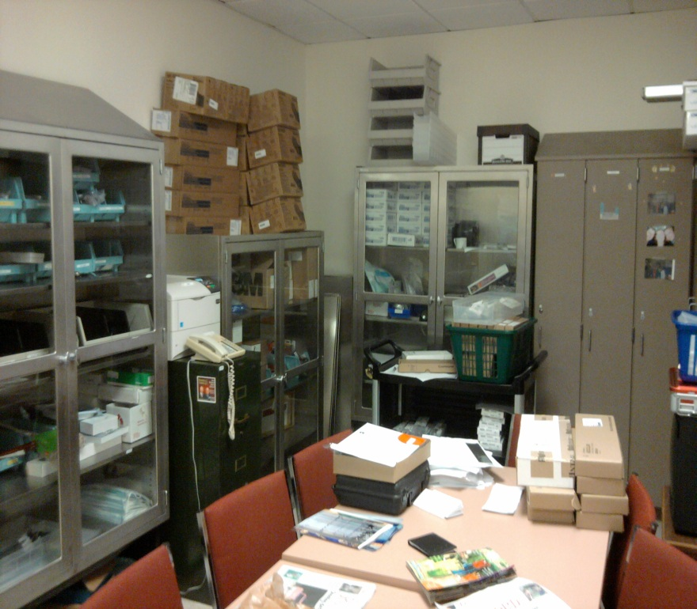
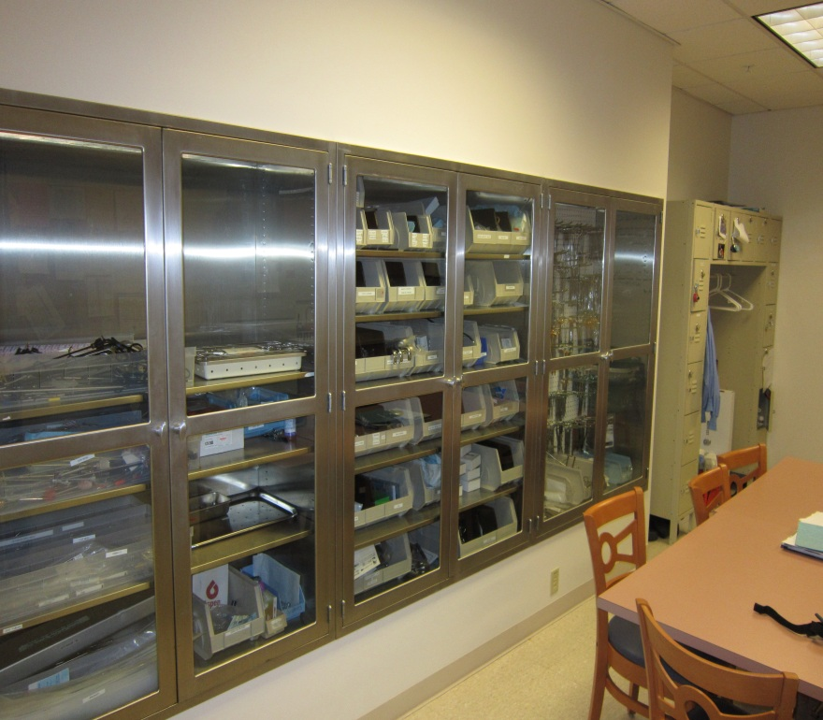
5S STERILE PROCESSING
BEFORE
AFTER
Before – General storage in the break room was all over the place.
After – Recessed cabinets made the space more efficient and organized.

Slide 12
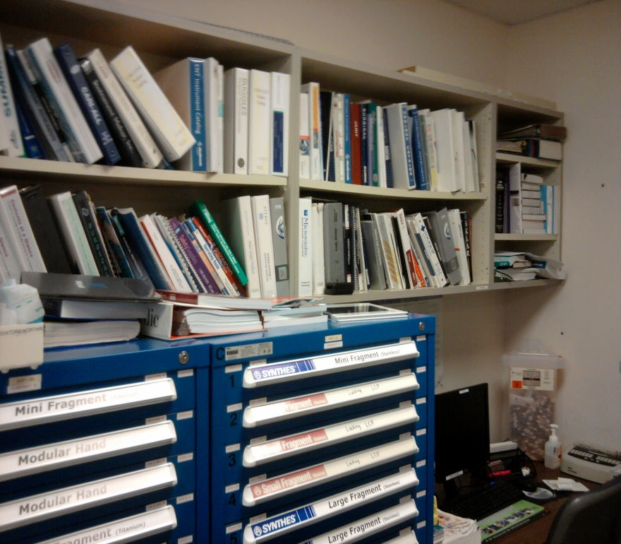
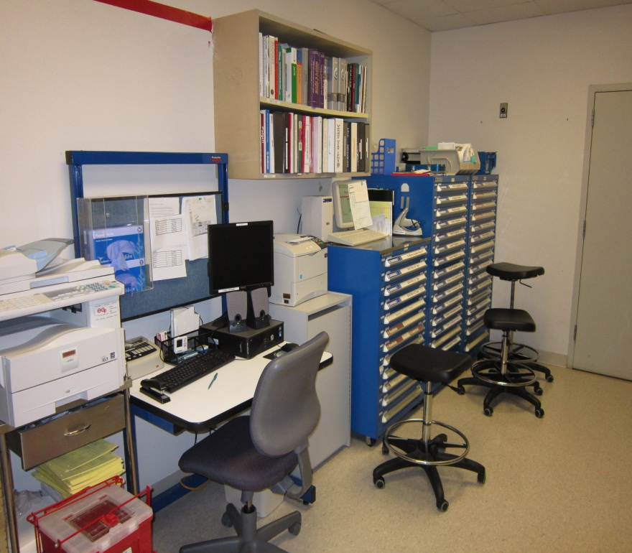
5S STERILE PROCESSING
BEFORE
AFTER
Before – Office space had a lot of unneccessary books and was cramped.
After – Workspace more organized and only releveant publications remain. Notice the red line on the After picture on the wall. We can’t legally store anything above that line so poka-yoke comes into play here.

