Slide 1
Flagler Hospital Leadership Development _____________ Nurse Communication Pain Management
Regina Shupe MSN RN
Julie Kennedy BSN RN

Slide 2
Why Do Patients Come?
HCAHPS COMPOSITE | Correlation
Yes, Patients Would Recommend the Hospital | .907
Nurses Always Communicated Well | .780
Pain Was Always Well Controlled | .709
Patients Always Received Help As Soon As They Wanted | .702
Room was Always Clean / Always Quiet at Night | .668/.571
Doctors Always Communicated Well | .631
Yes Patients Were Given Information About What to Do During Their Recovery | .571

Slide 3
HCAHPS Composites | 1Q11-4Q11 | 3Q12 | 4Q12TD | ∆ Rank | Tactics
Patients who gave a rating of 9 or 10 (high) | 81 | 79 | 76 | -3
Doctors always communicated well | 6 | 33 | 75 | 42 | Physician leader rounding, AIDET®
Nurses always communicated well | 13 | 51 | 74 | 23 | Nurse Leader rounding, white boards, AIDET®, IPC bedside shift report
Pain was always well controlled | 59 | 64 | 54 | -10 | Nurse Leader Rounding Hourly Rounding℠
Patients always received help as soon as they wanted | 40 | 44 | 66 | 22 | Nurse Leader Rounding Hourly Rounding℠
Always quiet at night | 17 | 30 | 57 | 57 | Interdepartmental Survey & Interdepartmental Rounding
Room was always clean | 77 | 59 | 74 | 15
Staff always explained about medicines before giving to patients. | 88 | 63 | 73 | 10 | AIDET®, Bedside Shift Report, M in Box
Yes, patients were given information about what to do during their recovery | 54 | 83 | 88 | 5 | Post visit clinical calls
Notes:
3

Slide 4
The Questions in Nurses Always Communicated Well Domain
During this hospital stay, how often did the nurses treat you with courtesy and respect?
During this hospital stay, how often did nurses listen carefully to you?
During this hospital stay, how often did nurses explain things in a way you could understand

Slide 5
Other Composites Influenced by Nurse Communication?
Pain was always well controlled
Patients always received help as soon as they wanted
Room was always clean / Always quiet at night
Doctors always communicated well
Patients were given information about what to do during their recovery

Slide 6
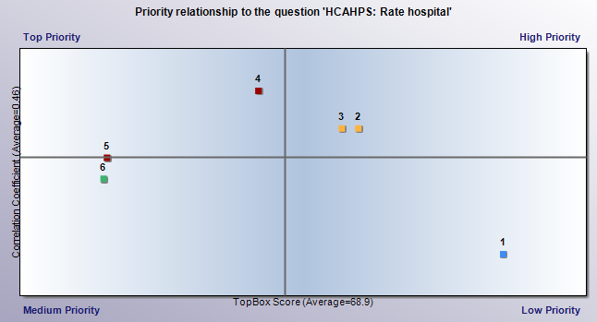
Priority Index~ Catalyst Data Oct 2012-Nov 2012

Slide 7
Nurses Communicate by ALWAYS…
Narrating Care
Hardwiring AIDET®
Hardwiring whiteboards as a communication tool for the care team
Hardwiring the full scope of “SG Tool Box”
Hourly Rounding℠
Individualized Patient Care
Bedside Shift report
Post Visit Clinical calls
M in the Box

Slide 8
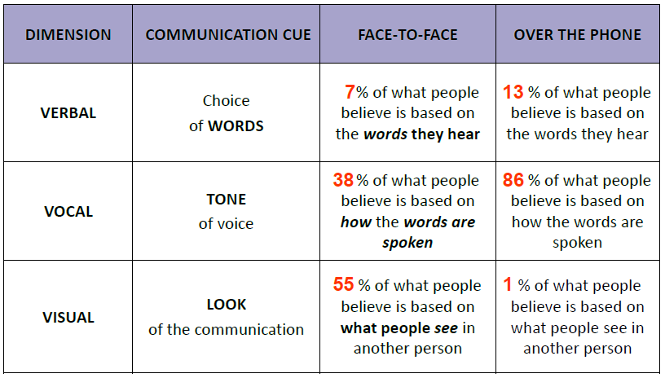
What We Know About Communication…

Slide 9
Courtesy and Respect
Starts with listening carefully and explaining
Behaviors matter!
Vocal and Visual matter!
Coach what a therapeutic relationship looks like
Notes:
Active Listening
Eye contact
Tone of voice
Appropriate speed of speech
Appropriate use of touch
No multi-tasking
Appropriate use of humor/emotion
Physical positioning – sitting, kneeling, etc.
Read body language!

Slide 10
Listen Carefully
Eye Contact
Don’t overuse multi-tasking
Use strategies such as repeating back and asking probing questions
Use AIDET®
JULIE’s RULE: If you don’t have time to listen to a long answer then ask tighter questions!!

Slide 11
Explain Things
Ask questions to assess understanding
Explain at appropriate education levels
Use teach back method
JULIE’s RULE: Pay with time now or pay with time later

Slide 12
The New Questions (Jan 2013) are rooted in Communication
During this hospital stay, staff took my preferences and those of my family or caregiver into account in deciding what my health care needs would be when I left. They listened
When I left the hospital, I had a good understanding of the things I was responsible for in managing my health. They explained
When I left the hospital, I clearly understood the purpose for taking each of my medications. They explained

Slide 13
Validation
Nurse Leader Rounds – on staff to share the why and on patients to assess for always care and give them a voice
Nurse Leader Rounds – on patients to assess for always care and give them a voice
Shoulder-to-shoulder Direct Observation – with immediate feedback (novice to expert)
Whiteboard and Rounding Log Checks – to check that the task was done

Slide 14
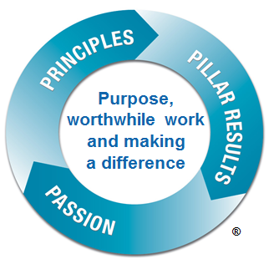
Inspiration
Role Model
Tell the WHY, over and over and over and over
Connect to Purpose (Sr. Mary Francis Regis)
JULIE’s INSPIRING
KEY WORDS

Slide 15
Execution Framework Evidence-Based LeadershipSM
Breakthrough
Foundation
STUDER GROUP®:
Objective Evaluation System
Leader Development
Must Haves®
Performance Gap
Standardization
Accelerators
Aligned Goals
Aligned Behavior
Aligned Process
Develop LEM goals for Nurse Communication domain
Weight units based on current results. Don’t be afraid of weights!
Add HCAHPS results to evaluations
Educate leaders how to:
Engage staff
Share the WHY
Validate and Inspire behaviors
Critical Conversations
Huddles
Nurse Leader Rounds
Hourly Rounding℠
Post Visit Clinical calls
KWKT- Narrate care
Individualized Patient Care
Whiteboards
M in the Box
Reward and recognize or coach/counsel as appropriate to reinforce behaviors and achievement of results
Processes that are consistent and standardized
Process Improvement
PDCA
Lean
Six Sigma
Baldrige Framework
Software
Notes:
Second most important foundational slide next to flywheel is this slide focusing on the execution framework – Evidence-based leadership.
Process improvement, re-engineering, etc. This is not a stand alone item – it will not get you there.
We focus a lot on the aligned goals (dark blue) and Aligned Behavior (yellow)
Aligned Behavior:
Tactics and Behaviors
Dealing with low performance
Aligned Goals:
Biggest miss is aligning goals. Don’t evaluate on competency….but rate on outcomes. Is your evaluation system outcome oriented and weighted?
Skill/Leader Training: Key part of outcomes and success.

Slide 17
Flagler Hospital Leadership Development _____________ Pain Management
Regina Shupe MSN RN
Julie Kennedy BSN RN

Slide 18
Only 1/3 rated pain relief in hospital in final two days of life as excellent
1/2 stated that nurses did not treat their dying family member with dignity and respect
Hospital care was rated worse than dying at home, in a nursing home, or in a hospice in almost all of the 59 questions
Responses from 22,000 families

Slide 19
Before We Begin…
Do we have pain management policies and procedures in place for those that need medication?
Do we consider pain the 5th vital sign?
Do we consider pain an emergency ?
Have providers and nurse been trained how to assess pain and how to document a pain assessment and reassessment?

Slide 20
And the Hardest Questions of All
Do we think all patients are exaggerating their pain?
Do we judge patients pain by OUR pain scale?
Do we generalize pain assessments so that as our career progresses we begin to believe that everyone with a kidney stone, HA, tooth ache or _____ (add your favorite seeking diagnosis here) is seeking drugs for other than acute pain relief??

Slide 21
A Call to Action
Lay the drug seekers aside and be sure that our patients who need pain management are well managed to the best of our ability and caring

Slide 22
Factors Associated with Drug-Seeking
Specific request for narcotics
Previous documented visits for suspected drug-seeking
Unwillingness to try simple analgesia
Aggressive or demanding behavior

Slide 23
The Questions in Pain Well Controlled Domain
During this hospital stay, did you need medicine for pain?
During this hospital stay, how often was your pain well controlled?
During this hospital stay, how often did the hospital staff do everything they could to help you with your pain?

Slide 24
The ‘Why’
Pain is most often the reason the patient is not still sick at home
Pain in often an indication of a clinical issue
Pain has a correlated influence over other composites
Pain management brings providers and clinicians to the table for discussion of patient perception of care in a way that is purely related to clinical team patient care management

Slide 25
The ‘Why’

Slide 26
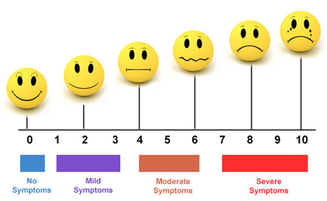
This is not a pain severity scale!
This is a agreed-upon starting place, in which the goal is to move to the left
Move this way
Not this way

Slide 27
A Patients Pain Scale
... What is the rule??
Notes:
0: Hi. I am not experiencing any pain at all. I don't know why I'm even here. 1: I am completely unsure whether I am experiencing pain or itching or maybe I just have a bad taste in my mouth. 2: I probably just need a Band Aid. 3: This is distressing. I don't want this to be happening to me at all. 4: My pain is not messing around. 5: Why is this happening to me?? 6: Ow. Okay, my pain is super legit now.
7: I see a white light coming for me and I'm scared. 8: I am experiencing a disturbing amount of pain. I might actually be dying. Please help. 9: I am almost definitely dying. 10: I am actively being mauled by a bear. 11: Blood is going to explode out of my face at any moment. Too Serious For Numbers: I probably have ebola. It appears that I may also be suffering from Stigmata and/or pinkeye.

Slide 28
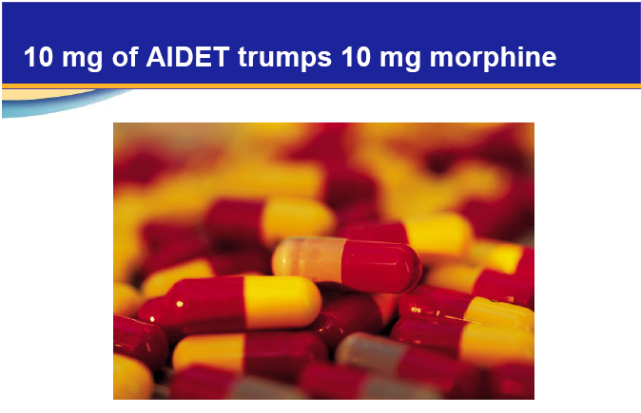
Staff and Provider Assessment
Do we have competencies associated with pain management ?

Slide 29
Use your Nursing Tool Box
“Mr. Jones, I want to do everything I can to help with your pain, let’s try . . .
Positioning Deep Breathing
Elevate Splinting
Isolate Relaxation techniques
Heat/cold Music
Distraction Aromatherapy
Massage

Slide 30
Use your SG Tool Box
Huddles utilized to update on results progress and patients with unresolved pain, share what has worked and to highlight wins
Whiteboards used to document established pain goal for every patient and when next dose is available
Hourly Rounding® focus the eight behaviors to ensuring pain is well managed and include the family

Slide 31
Use Your SG Tool Box
Bedside shift report ensuring that pain is included in the conversation 100% of the time and that the patient can report back the side effects of their new pain medications
Post visit clinical call questions directed at making sure the patient is progressing as expected
Sample Questions:
“Did you get your prescription for your pain medication filled”
“Tell me when you last took pain medication and has it helped your pain?”
“Is your pain better today than yesterday or progressing as you expect?”

Slide 32
Individualized Patient Care

Slide 33
Validation
Nurse Leader Rounds
Post-visit phone calls
Logs
Huddles
Chart audits
Rewarding and Recognizing/ Coaching and Counseling

Slide 34
Inspiration
Role modeling
Making pain management a important part of clinical practice
Share stories!
Share comments

Slide 35
Go to the Next Level !
Involve the medical staff in developing patient protocols and treatment regimens for our most challenging patients
Develop criteria for defining ‘unresolved pain’ event
Nurse Manager intervenes with physician in 100% of unresolved pain events
All unresolved pain events included in Huddles, just like falls or other sentinel events

Slide 36
Go to the Next Level !
Remove language “drug seeking” – remove judgment
Share research on “Opiate Tolerant” patients
Ancillary and support departments such as PT, RT and Pharmacy involvement in shared departmental care planning

Slide 37
For Chronic Pain Patients
RN to accompany provider on rounds daily to discuss and solidify pain management plan
RN’s to validate pain management plan of care during each bedside shift report daily
RN’s to offer other comfort measures such as repositioning, pillows, ice pack, dimming lights, etc. to demonstrate compassion and assist with patient comfort level
Shift leaders to round on patients daily to validate agreed upon behaviors

Slide 38
Execution Framework Evidence-Based LeadershipSM
Breakthrough
Foundation
STUDER GROUP®:
Objective Evaluation System
Leader Development
Must Haves®
Performance Gap
Standardization
Accelerators
Aligned Goals
Aligned Behavior
Aligned Process
Develop LEM goals for Pain Domain
Weight units based on current results. Don’t be afraid of weights!
Use chart review as an evaluation of pain management
Educate leaders how to:
Engage staff
Share the WHY
Validate and Inspire behaviors
Critical Conversations
Huddles
Nurse Leader Rounds
Hourly Rounding℠
Post Visit Clinical calls
Nurse Toolbox
Collaboration!
Reward and recognize or coach/counsel as appropriate to reinforce behaviors and achievement of results
Processes that are consistent and standardized
Process Improvement
PDCA
Lean
Six Sigma
Baldrige Framework
Software
Notes:
Second most important foundational slide next to flywheel is this slide focusing on the execution framework – Evidence-based leadership.
Process improvement, re-engineering, etc. This is not a stand alone item – it will not get you there.
We focus a lot on the aligned goals (dark blue) and Aligned Behavior (yellow)
Aligned Behavior:
Tactics and Behaviors
Dealing with low performance
Aligned Goals:
Biggest miss is aligning goals. Don’t evaluate on competency….but rate on outcomes. Is your evaluation system outcome oriented and weighted?
Skill/Leader Training: Key part of outcomes and success.

Slide 40
Julie Kennedy BSN, RN Studer Coach www.studergroup.com julie.kennedy@studergroup.com
If you want to build a ship don’t tell people to collect wood
and don’t assign them tasks and work
but rather teach them to long
for the endless immensity of the sea
-Antoine de Saint-Exupery

